Slide 1














Engaging Internet-based Quiz App
Done By:
M.Ram Jeyanth(192211167)
S.Hariharan(192211110)
S.Abishek(192211606)
Internet Programming
SSE,SIMATS
Guided by:
Dr.Jayasakthi Velmurugan
(Course Faculty)
Internet Programming
SSE,SIMATS

Slide 2



Abstract
This abstract delves into a dynamic quiz application crafted using HTML, CSS, and JavaScript, aimed at transforming online learning experiences. Employing HTML's structural prowess ensures content clarity and accessibility, while CSS enhances visual aesthetics, captivating user engagement. Leveraging JavaScript functionalities such as timers and score tracking, users experience interactive challenges, fostering active learning participation. The user-centric design fosters seamless navigation through diverse quiz categories, promoting user satisfaction and retention. Embracing responsive design principles ensures cross-device compatibility, enabling ubiquitous access. This application stands as a testament to HTML's integral role in modern internet programming, shaping the future of interactive education.

Slide 3
INtroduction
**Welcome to Our Quiz App: Where Knowledge Meets Fun!**
Dive into an immersive world of quizzes tailored to intrigue and entertain. With a vast array of topics, there's something for everyone to enjoy. Challenge yourself with thought-provoking questions designed to stimulate your intellect. Engage in friendly competition with friends or go head-to-head with players from around the world. Our intuitive interface, crafted with HTML logic, ensures a seamless experience across all devices. Every quiz is an opportunity to expand your horizons and learn something new. So, what are you waiting for? Join us on this exciting journey of exploration and discovery today!

Slide 4





Hard ware and Software requirements
SOFTWARE
HARDWARE
FILES
1)Processor:11th gen Intel i5-11400h
@2.70ghz 2.69Ghz64-Bit Operating system
2)Storage:512 GB
3)Memory:8 GB
4)Graphic card:In-built Radeon Graphics
1)OS:Windows 10 or 11
2)XAMPP Control panel
3)Integrated development environment(IDE):
Visual Studio
4)Notepad
1)For HTML,it should be stored as.html
2)For PHP,it should be stored as .php
3)for CSS,it should be stored as .css

Slide 5

Existing System
-The existing system for a Quiz app using HTML logic in terms of internet programming likely consists of several key components:
User Interface (UI):The HTML markup defines the structure of the Quiz app's UI. This includes elements such as questions, multiple-choice options, buttons for submitting answers, progress indicators, and feedback messages.
Styling (CSS):Cascading Style Sheets (CSS) are used to enhance the visual appearance of the Quiz app's UI. This involves defining colors, fonts, layouts, and other visual aspects to create an engaging and user-friendly experience.
Functionality (JavaScript):JavaScript is employed to add interactivity and dynamic behavior to the Quiz app. This includes functionalities such as handling user input, validating answers, calculating scores, displaying results, and managing the quiz flow (e.g., moving to the next question).
Data Management:The Quiz app may utilize various data management techniques to store and retrieve quiz questions, options, correct answers, and user progress. This could involve storing data directly within the HTML/JavaScript code, using JavaScript objects or arrays, or fetching data from external sources such as databases or APIs.
User Experience (UX) Considerations:The design and implementation of the Quiz app should prioritize a seamless and intuitive user experience. This involves considerations such as clear instructions, responsive design for different screen sizes, accessibility features, and error handling.

Slide 6

Proposed System
User Authentication:Implement a secure login system using HTML forms and server-side scripting languages like PHP or JavaScript to authenticate users before accessing quizzes.
Quiz Selection:Provide users with a selection of quizzes categorized by topics or difficulty levels, allowing them to choose the quiz they want to attempt.
Question Presentation:Utilize HTML elements to present questions and multiple-choice options in a visually appealing and user-friendly format.
Timer Functionality: Incorporate JavaScript to add a timer feature, enhancing the challenge and excitement of completing quizzes within a set time limit.
Scoring System:Develop a scoring mechanism to track users' performance based on correct answers, with real-time feedback displayed after each question.

Slide 7
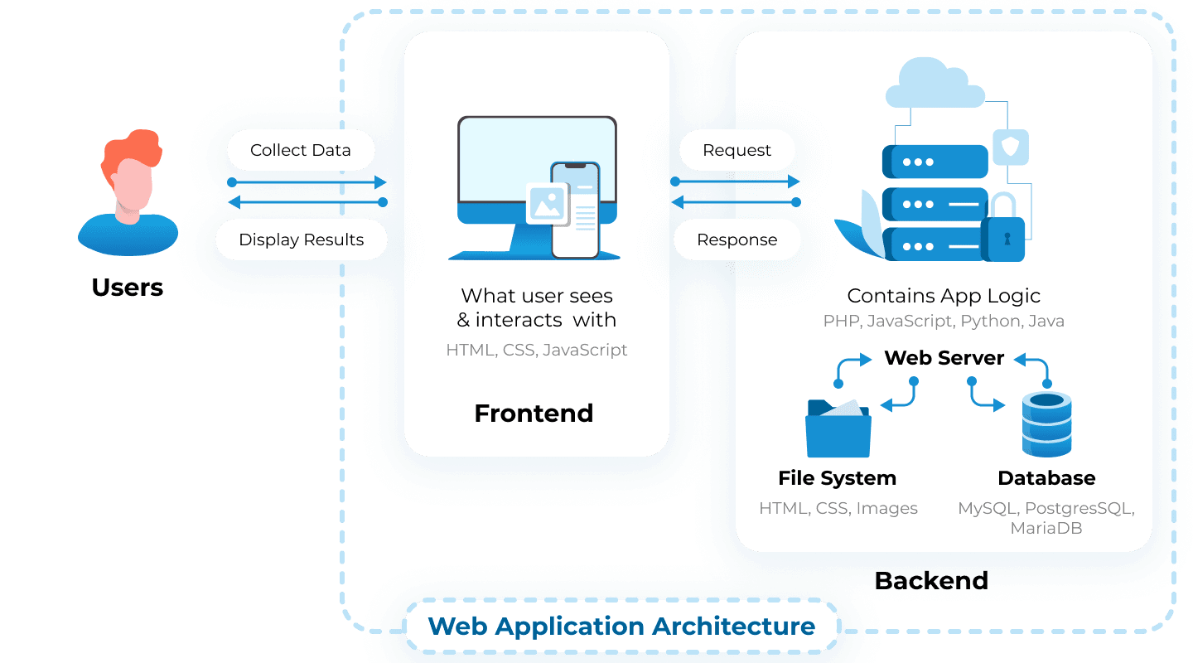
Architecture

Slide 8
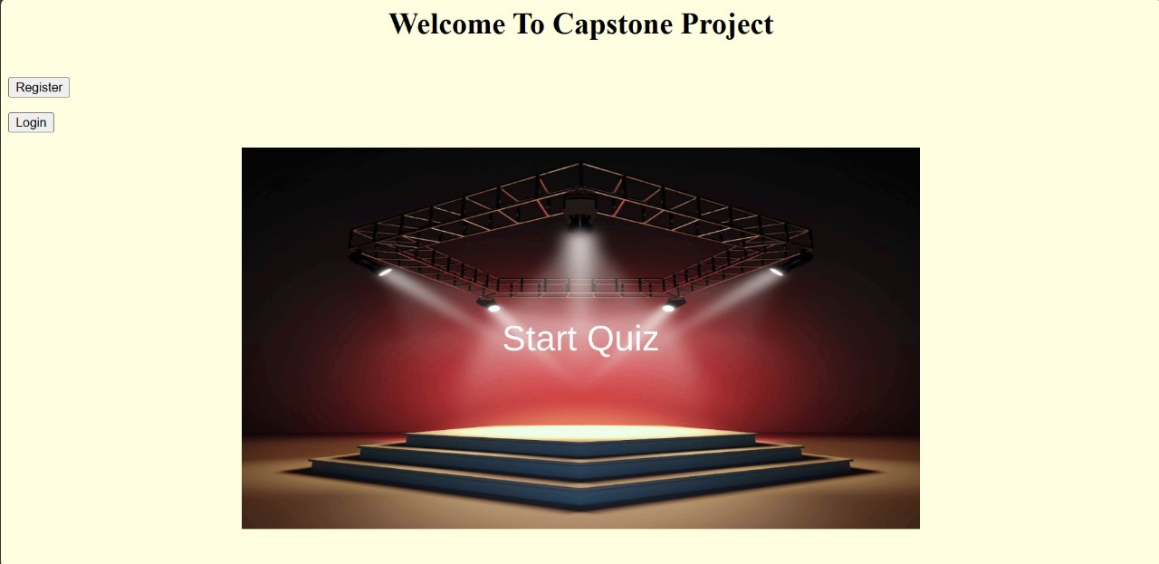
Design

Slide 9
Testing
In testing our Quiz app built with HTML logic for Internet programming, we meticulously examine its functionality and user experience. We verify that the quizzes load smoothly across different devices and browsers, ensuring seamless accessibility. Our focus extends to assessing the accuracy of the questions and the clarity of the interface. Through rigorous testing, we aim to identify and address any potential bugs or glitches that may arise during gameplay. User feedback is also instrumental, guiding us in refining the app for optimal performance and enjoyment. With each test, we strive to uphold the app's reliability, usability, and overall satisfaction for every player.

Slide 10
Implementation
- Our Quiz app implementation utilizes HTML for structuring content and creating a user-friendly interface.
- Internet programming techniques are employed to ensure seamless connectivity and data exchange.
- JavaScript enhances interactivity, allowing for dynamic content updates and user input validation.
- Responsive design principles ensure optimal viewing experiences across devices.
- Quizzes are presented in an intuitive format, guiding users through thought-provoking questions.
- Real-time feedback mechanisms keep users engaged and informed of their progress.
- HTML forms facilitate user interaction, enabling seamless quiz navigation and submission.
- Overall, our Quiz app leverages HTML logic and internet programming to deliver a captivating and accessible experience for users.

Slide 11
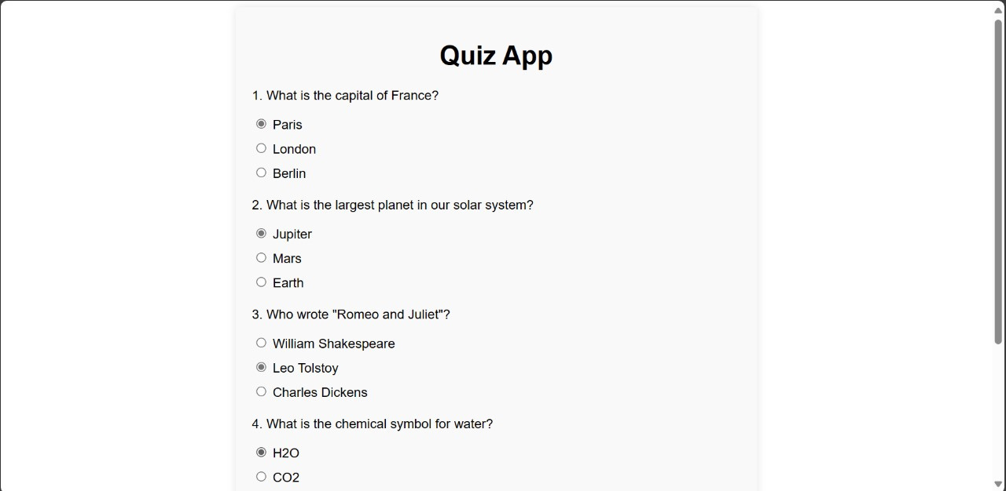
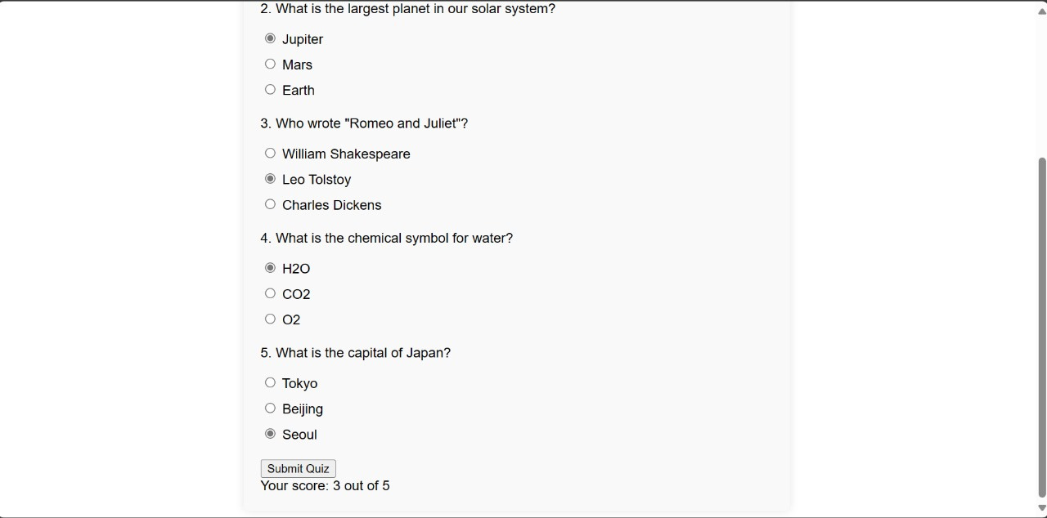
Final output

Slide 12

Conclusions
In conclusion, our Quiz App, powered by HTML logic and internet programming, offers an engaging platform for users to explore and challenge their knowledge. With a diverse range of topics and interactive features, it caters to a wide audience seeking entertainment and intellectual stimulation. The seamless user experience across devices ensures accessibility and convenience. As users dive into the quizzes, they not only compete but also learn, making each session a rewarding experience. Whether playing solo or against friends, our Quiz App fosters a sense of community and camaraderie. Join us on this journey of discovery, where fun and learning intersect in the digital realm.

Slide 13
References
1. Mozilla Developer Network (MDN): This platform offers extensive documentation and tutorials on HTML, CSS, and JavaScript, providing invaluable insights into building interactive web applications (Mozilla Developer Network, n.d.).
2. W3Schools and Codecademy: These online learning platforms provide structured courses covering HTML and internet programming concepts, serving as valuable resources for mastering foundational skills (W3Schools, n.d.; Codecademy, n.d.).
3. Stack Overflow: As a prominent online community, Stack Overflow serves as a go-to destination for troubleshooting and seeking advice from experienced developers, offering solutions to various programming challenges (Stack Overflow, n.d.).
4. GitHub Repositories: Exploring GitHub repositories containing open-source projects related to quiz applications can offer practical examples and inspiration for implementation (GitHub, n.d.).
5. Web Development Blogs: Staying informed with insights from web development experts through blogs and articles from platforms like Smashing Magazine and A List Apart can provide updates on the latest trends and techniques in internet programming for creating engaging quiz applications (Smashing Magazine, n.d.; A List Apart, n.d.).

Slide 14

Thank you very much!

